Slide 1
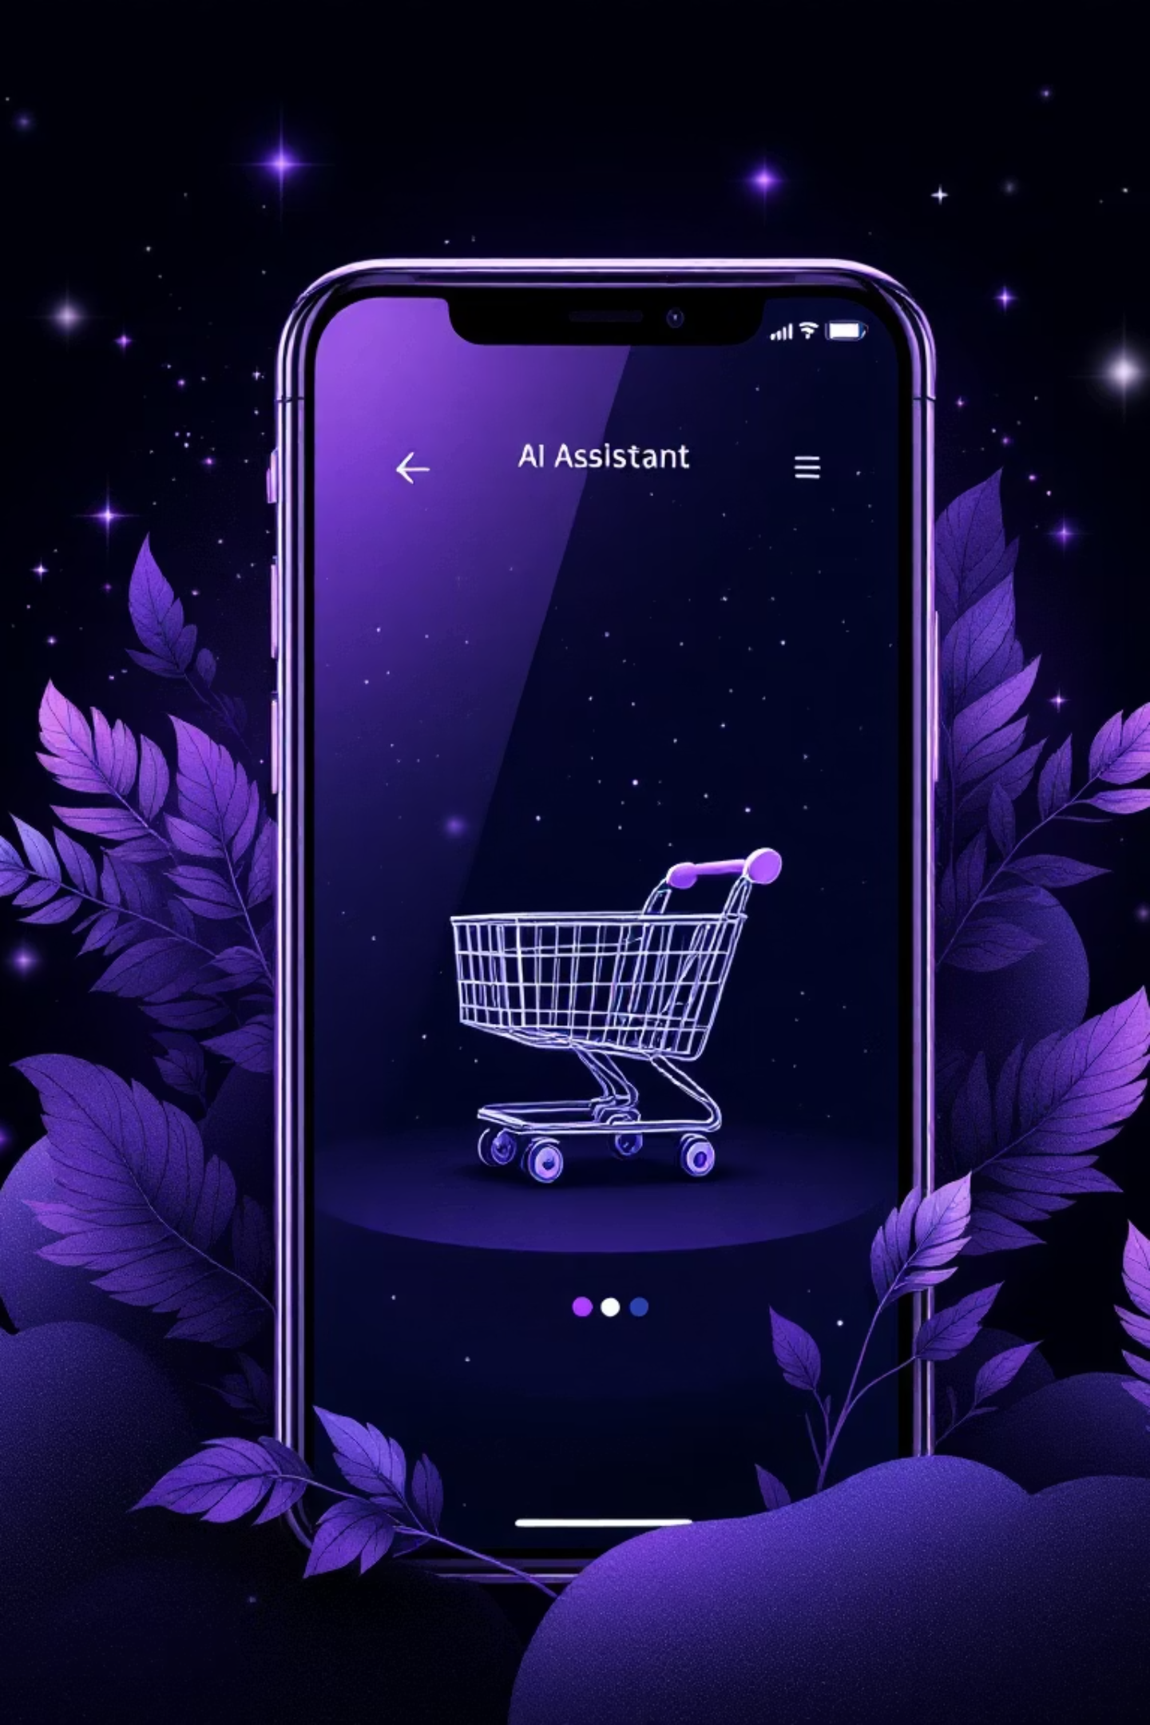
Product Assistant: AI-Powered Shopping Experience
Welcome to Product Assistant, a comprehensive .NET MAUI mobile application that redefines online shopping. We offer a unified conversational shopping experience, leveraging AI to make product discovery intuitive and engaging.

Slide 2

The Power of Unified Search & Chat
Natural Language Interaction
Intelligent Product Discovery
Chat with our AI assistant just like a personal shopper. No complex menus, just natural conversation.
The AI automatically detects your search intent and performs "grounding searches" to find exactly what you need.
Inline Product Display
One-Click Collection
See product results directly within your chat, eliminating the need to navigate between pages.
Easily add discovered products to your personal collection for later review or purchase.

Slide 3
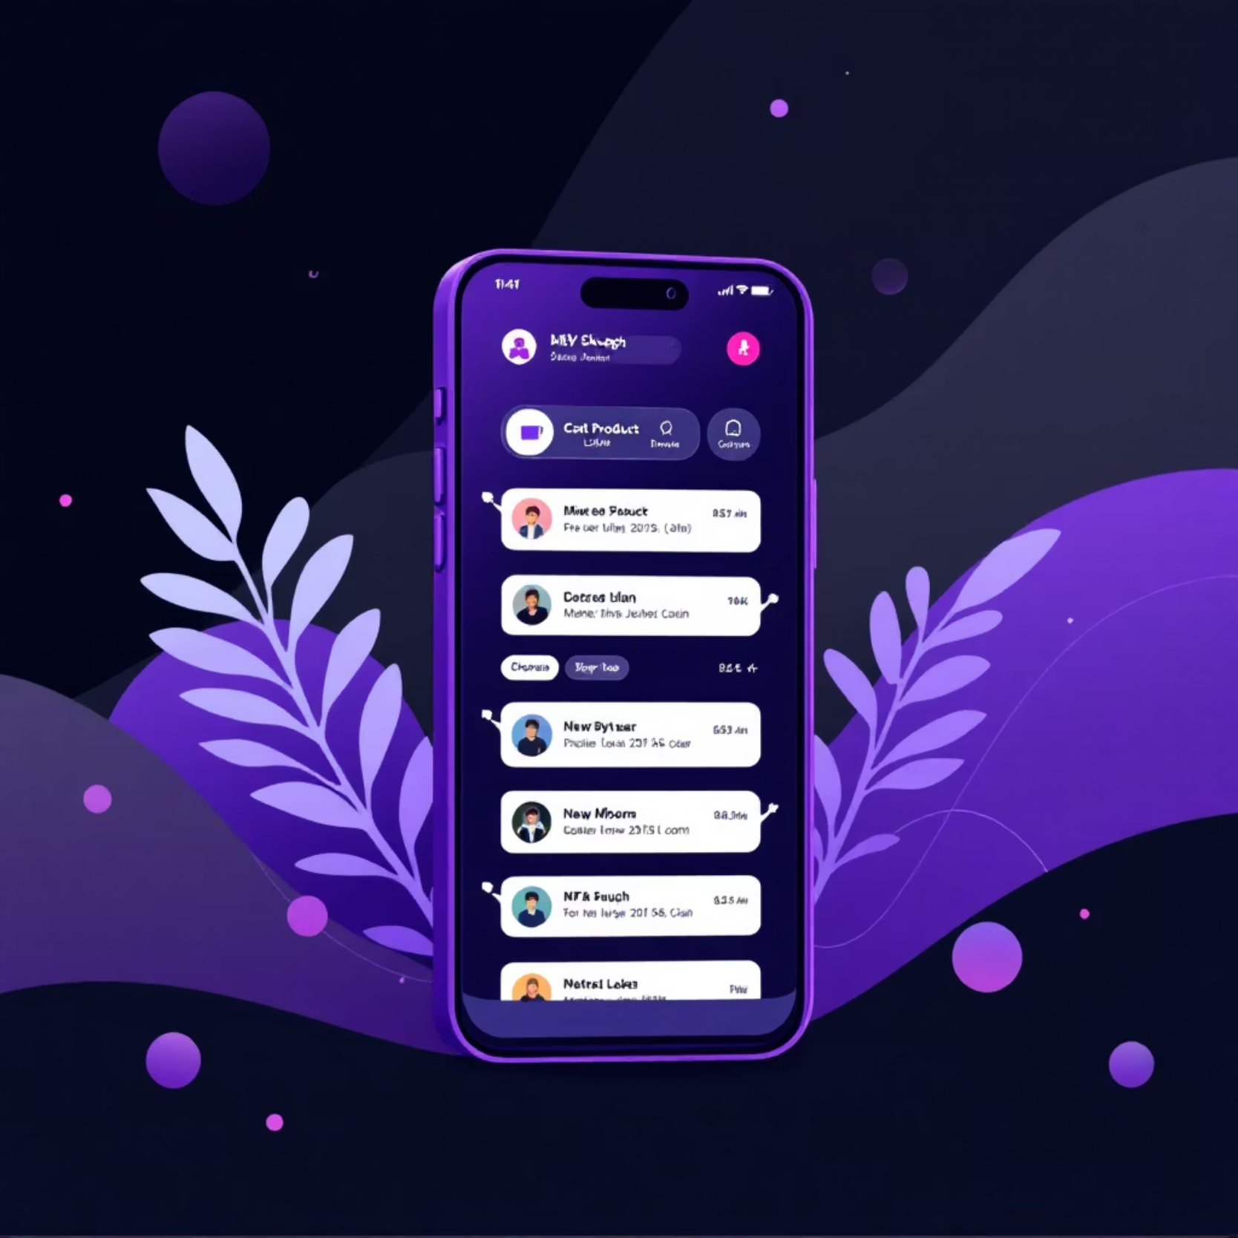
Core Features: Enhancing Your Shopping Journey
Unified AI Shopping Assistant
A single conversational interface for all your shopping needs.
AI detects search intent and performs automatic grounding searches.
Products are seamlessly displayed inline with the conversation.
Add products to your collection with a single tap.
My Collection Page
Organize and review all your saved products.
Search and filter your collection with ease.
Manage saved items with intuitive controls.

Slide 4





Architecture: Powering the Experience
Our application is built on a robust microservices architecture and follows the MVVM pattern for a scalable and maintainable solution.
AI Service
API Service
Integrates with Google Gemini API for intelligent conversations and grounding searches.
Main gateway for all client requests, orchestrating other services.
Scraping Service
Efficiently extracts product data from Arukereso.hu.
SQLite Database
Reliable file-based storage for products and conversation memory.
Mobile App (.NET MAUI)
The user-facing application providing a seamless shopping experience.

Slide 5
Key Technologies Driving Innovation
.NET MAUI 8.0
C# 12
Cross-platform mobile application framework for native experiences.
Leveraging modern language features for efficient and clean code.
Google Gemini API
Auth0
AI-powered conversational service for intelligent interactions.
Secure OAuth2/OIDC authentication for user access.
SQLite
Docker & Kubernetes
Lightweight, file-based database for local data persistence.
Containerization and orchestration for scalable deployments.

Slide 6
Seamless Experience: AI Tools in Action
Our AI assistant is equipped with advanced tools to provide a truly intelligent shopping experience. The core of this is the Grounding Search.
01
02
03
User Query
Intent Detection
Grounding Search
You ask naturally: "Find me a laptop under 50,000 HUF."
AI analyzes your message and understands you're looking for products.
AI automatically calls the SearchProductsTool, which queries our Scraping Service.
04
05
Inline Results
Interaction
Products from Arukereso.hu are seamlessly displayed within your chat conversation.
You can save products, ask follow-up questions, or refine your search.

Slide 7
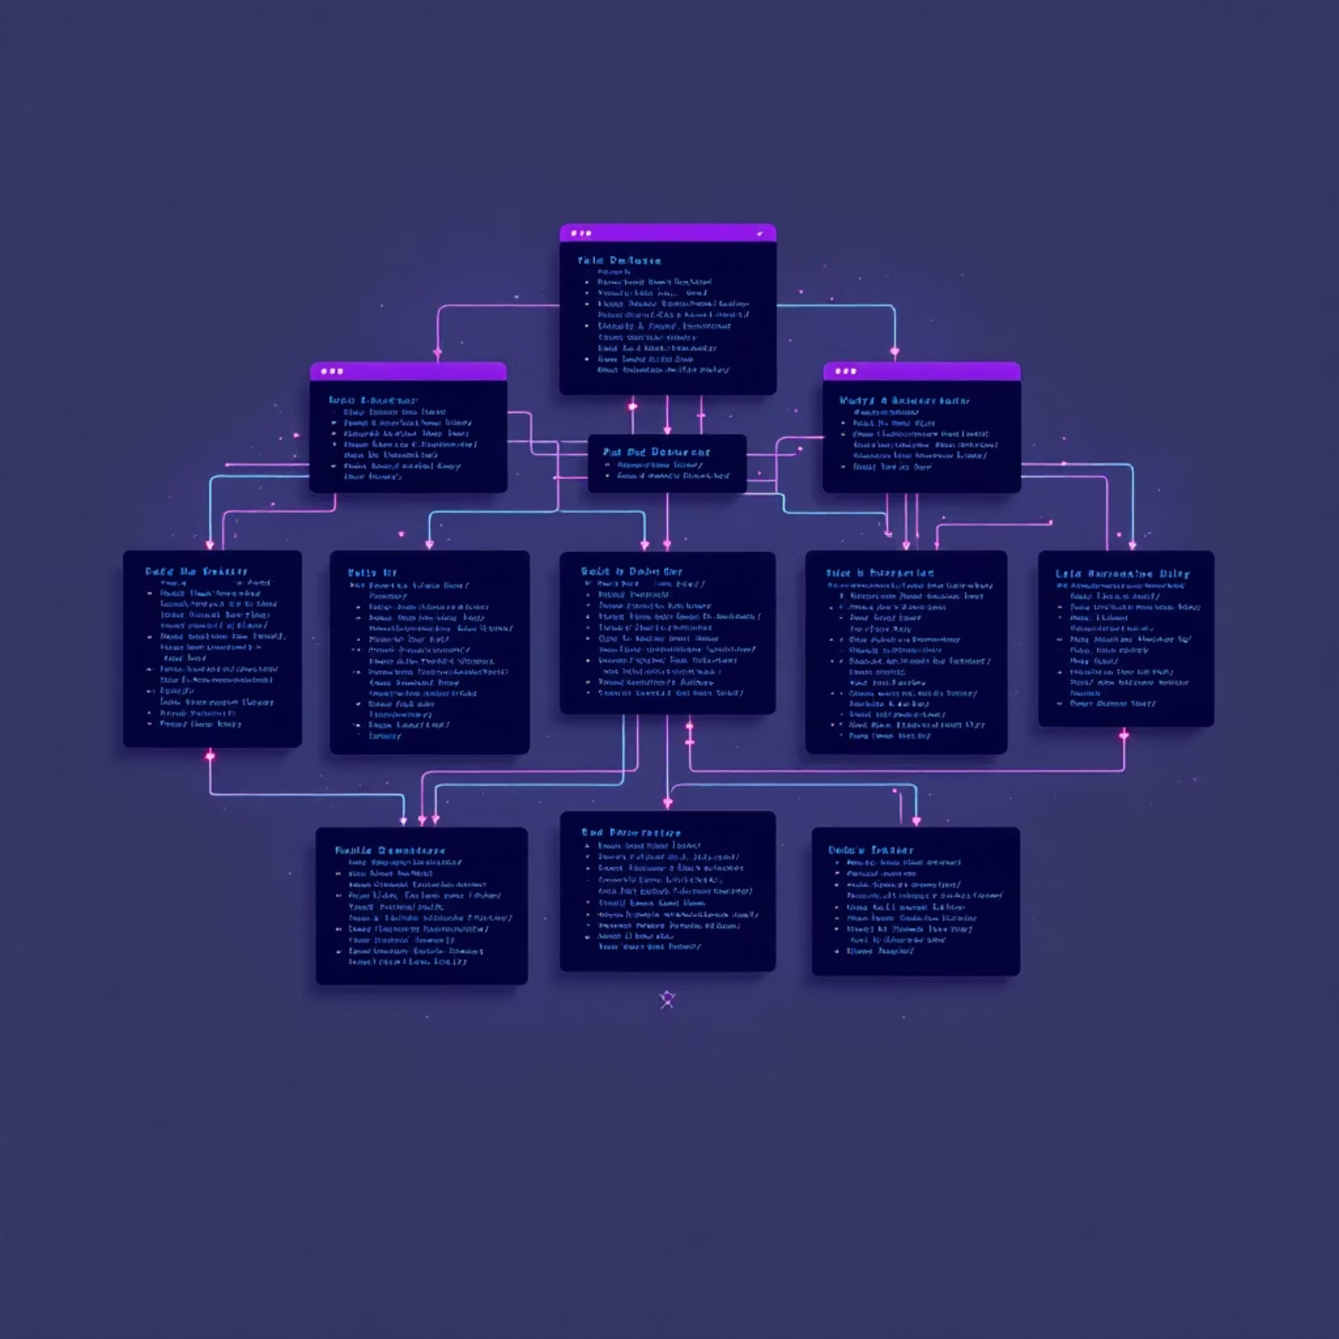
Robust Data Model: Organizing Your Information
Our data model is designed for efficiency and clarity, ensuring your product and conversation data is securely managed.
Product Entity
Id: Primary Key
Name: Product name
Price: Product price
ImageUrl & ProductUrl: Direct links for product information
UserId: Links products to specific users
Conversation Memory
Conversation Entity: Tracks entire conversations.
ConversationMessage: Stores individual chat messages with context.
Leveraging SQLite and Entity Framework Core, we ensure reliable data persistence and seamless user-specific data indexing.

Slide 8
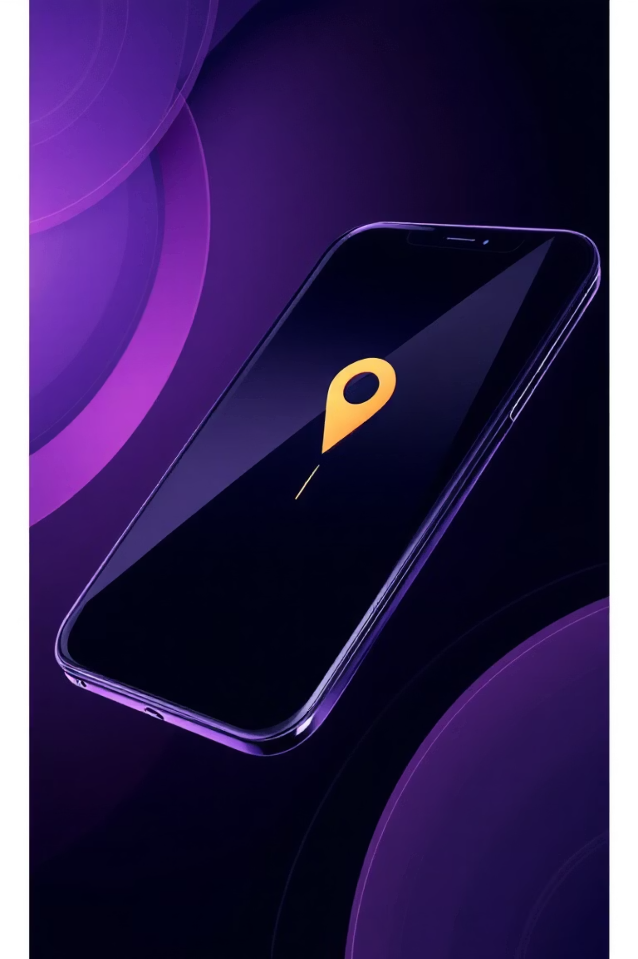
Device Features: Enhanced Mobile Experience
The Product Assistant mobile app integrates essential device features to provide a smooth and contextual user experience.
Network Connectivity Detection
Real-time monitoring of your network status.
Prevents API calls when offline, saving data and battery.
Enables smart data synchronization when connection is restored.
Geolocation Services
Retrieves your current location for personalized results.
Calculates distances to product stores for convenience.
Supports location-based product recommendations and store finding.

Slide 9
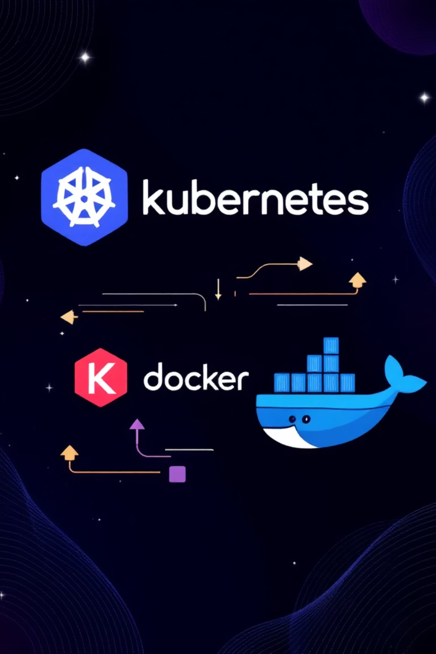
Deployment & Scalability
Whether for local development or production, Product Assistant is designed for flexible deployment using modern containerization and orchestration technologies.
Local Development with Docker Compose
Kubernetes Deployment
For production, deploy with Kubernetes for robust orchestration, scalability, and high availability.
Easily spin up all microservices with a single command for quick local testing and development.
CI/CD Integration
Automated build and deployment pipelines using GitHub Actions or Azure DevOps ensure continuous delivery.

Slide 10

Future Enhancements & Support
We are continuously working to improve and expand the capabilities of the Product Assistant.
Looking Ahead
Need Assistance?
Enhanced AI model selection and push notifications for price alerts.
Consult our detailed documentation files.
Barcode scanning, social sharing, and multi-language support.
Review error logs and verify configuration steps.
Advanced filtering, caching strategies, and analytics dashboards.
Refer to official documentation for .NET MAUI, Gemini API, Auth0, Docker, and Kubernetes.
This project fulfills the requirements for the .NET MAUI Semester Project, showcasing a comprehensive approach to modern mobile application development.

